Slide 1
OPF Visual SDK
Training & Demo
© 2011 Fidelity National Information Services, Inc. and its subsidiaries.

Slide 2
What is OPF Visual SDK?
Stand-alone graphical tool that simplifies the configuration of an OPF based implementation
A desktop application..!
Extremely easy to install..!
Captures functional requirements of an OPF-based project and generates the necessary OPF artifacts that are required during the development process
Standardizes the configuration of a custom OPF implementation
guides the user through the configuration process and applies best practices and consistency checks
significantly reduces the overall implementation time
minimizes the amount of errors

Slide 3

What is OPF Visual SDK?
This is a repository for requirements maintained by both
__ functional
&
__technical team members
and generates code/sql/… to keep requirements & code base in sync.

Slide 4
Developed in Eclipse RCP
Eclipse Rich Client Platform is a Platform for building Client applications with Rich functionality
generic, extensible and scalable GUI clients that facilitates extremely rapid and sustainable development
is built upon a plug-in architecture
Open Source (free) and started in 2003 (since Eclipse 2.1)
Based on a “workspace” concept which contains a set of projects, files and personal preferences
Views and editors are the building blocks of user interface.
an editor is associated with input activity of a document and is typically stored in a file on disk
a view shows support information about the active document

Slide 5
Installation & Configuration
How to organize your data:
Product Team (OPF)
Solution Team (XCT)
Project Teams (SEPA, BNYM, SIC, etc…)
OPF Visual SDK home & sub-directories
Distributions:
This will store local copies of the SVN repository. This is the directory in which you will checkout files from SVN
Workspaces:
This will hold the different workspaces that you are working on
Releases:
This will hold various releases of OPF Visual SDK product.

Slide 6
Installation & Configuration
OPF Visual SDK home page:
https://libra.clear2pay.com/vsdk/
OPF Visual SDK build release types:
7/6/2015 3:26 PM 602409 OPF Visual SDK - Release Notes 3.3.2.pdf 7/6/2015 2:49 PM 114582330 OPFVisualSDK-3.3.2_b20150629-r5206-build-linux.gtk.x86_64.zip 7/6/2015 2:49 PM 113904736 OPFVisualSDK-3.3.2_b20150629-r5206-build-macosx.cocoa.x86_64.zip 7/6/2015 2:31 PM 114269335 OPFVisualSDK-3.3.2_b20150629-r5206-build-win32.win32.x86.zip 7/6/2015 2:29 PM 114255793 OPFVisualSDK-3.3.2_b20150629-r5206-build-win32.win32.x86_64.zip 7/6/2015 2:54 PM 11415769 VSDK User Guide.pdf 7/6/2015 2:54 PM 21556727 vsdk-anttools-3.3.2_b20150629.zip 7/6/2015 2:54 PM 64 vsdk.licence

Slide 7
Installation & Configuration
Distributions:
A “Distribution” is a self-contained set of files, grouped into a well-defined directory structure that will hold the functionality of a given OPF layer.
The OPF Distribution will contain the OPF data dictionary, a set of default validation rules that can be included in other distributions, etc.
The regional development teams (e.g. SEPA, FedWire) will build their Distribution on top of OPF and include regional-specific functionality.
A project team will take the OPF and optionally the regional Distribution (depending on the kind of solution they are customizing) and add their project-specific requirements on top of this.

Slide 8
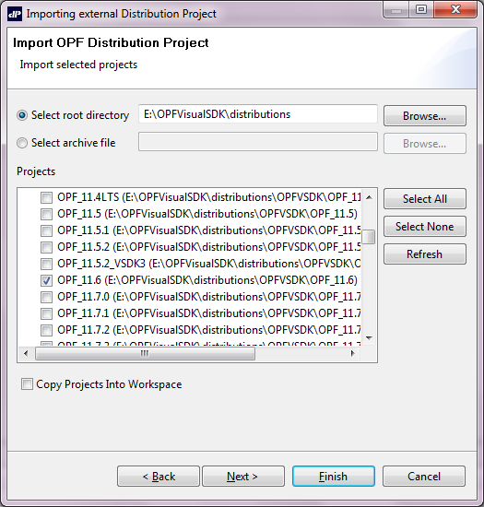
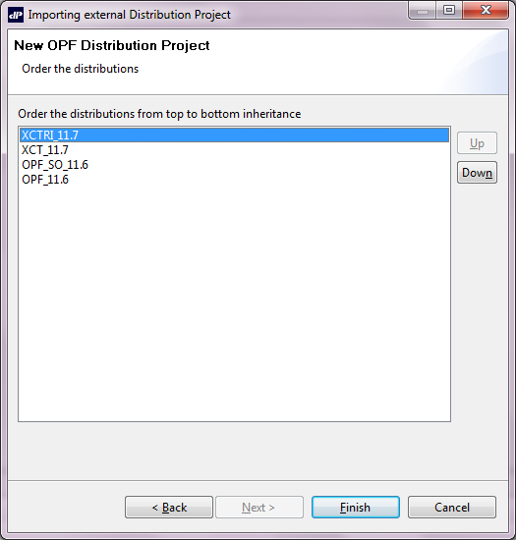
Installation & Configuration
Adding distributions

Slide 9
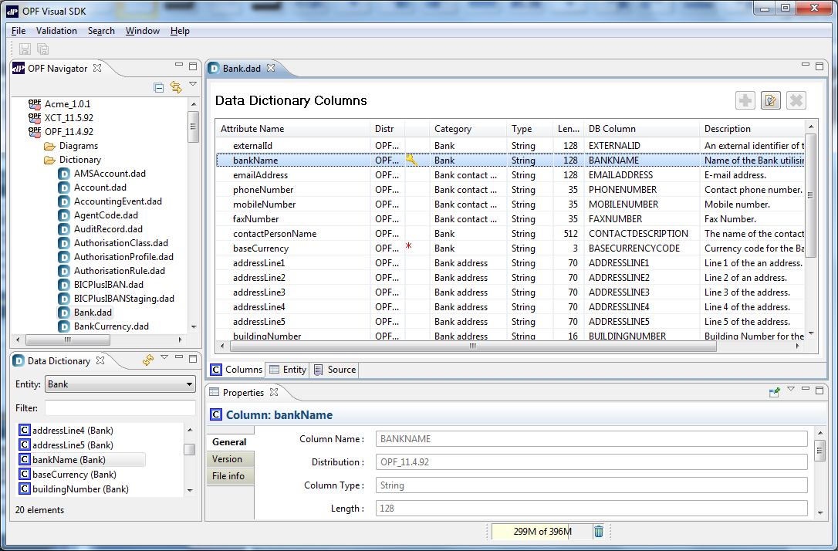
OPF Visual SDK as Eclipse RCP
Navigator View
Document Editor
Data Dictionary View
Properties View

Slide 10
ER Diagrams
Entity/Relationship Diagrams visualize the relationships between entities and representation in database
based on Data Dictionary across distributions
primary & foreign keys
“hidden” columns
version
whenmodified
Diagram contains user-selected entities
stored as .dsm file
Highly customizable graphs with DaDi integration
direct links to Data Dictionary files

Slide 11
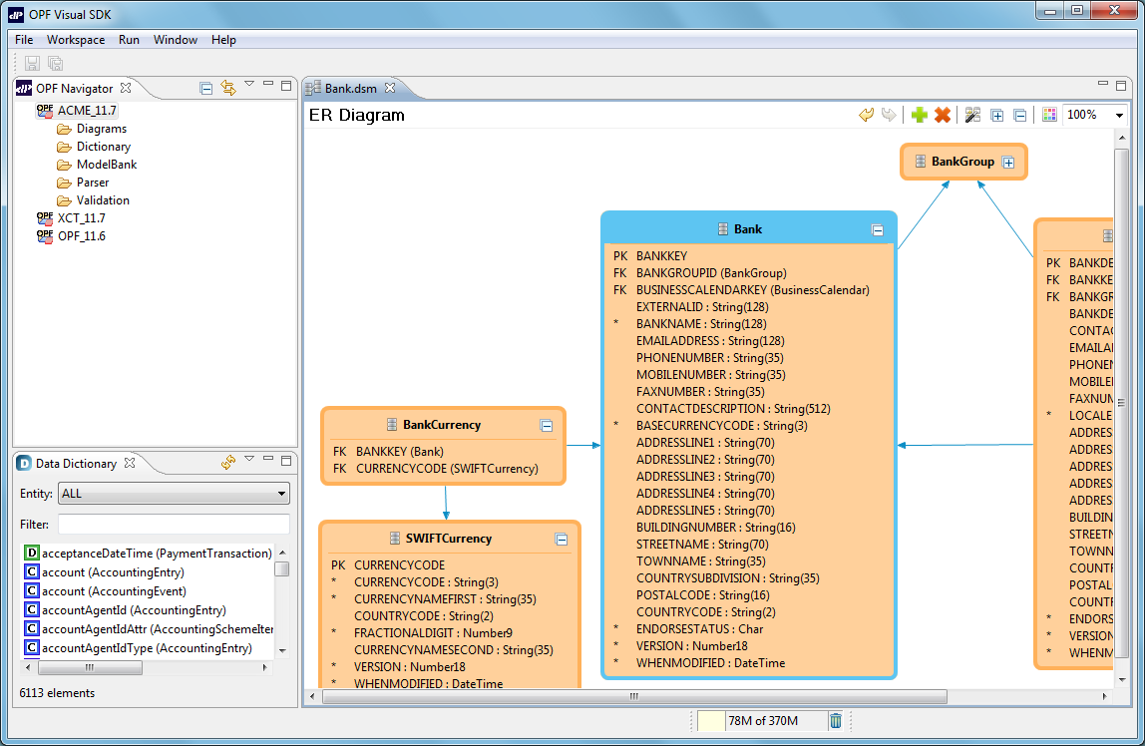
ER Diagrams
Entity relationships
Entity details

Slide 12
Data Dictionary
The Data Dictionary represents the business entities of OPF. Most entities store data in regular database columns. For some of these entities, OPF also stores information in one or more XML-typed columns.
A data entity can store data in 3 different locations:
Columns: Database column represent data which can be queried.
Details: XML data represent the functional data of a payment as received from the interchange.
ProcessingDetails: XML data represent information that is not part of the received payment data but is needed by OPF to process the payments (e.g. duplicateHashCode, releaseFromWareHouse-Date, ...).

Slide 13
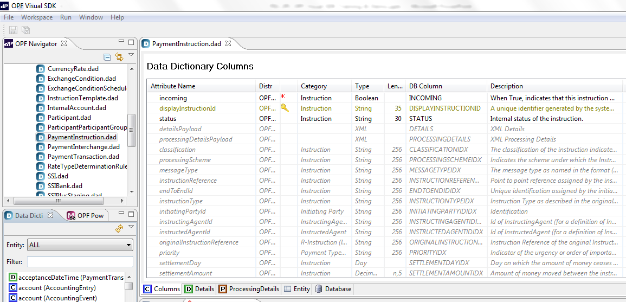
Data Dictionary

Slide 14
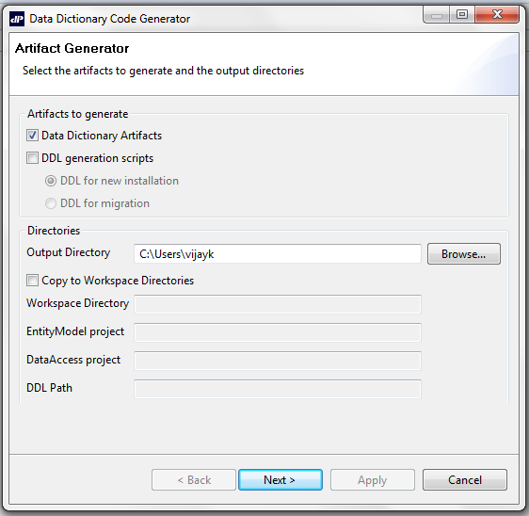
Data Dictionary Code Generation
By selecting “Generate Data Dictionary Code” from the “Run” menu in the menu bar, the tool will display the “Data Dictionary Code Generation” dialog box.

Slide 15
Model Bank
ModelBank represent the data for OPF entities that needs to be loaded in the database when installing OPF.
It contains the data for the static entities (BankGroups, Banks, etc…) that are needed to run an OPF installation.
OPF Visual SDK captures ModelBank data in “Data Sheets”.
For each entity, the data is represented in a table with rows and columns.
Every row presents one record in the database
Each column is an element of the Data Dictionary definition for that entity.

Slide 16
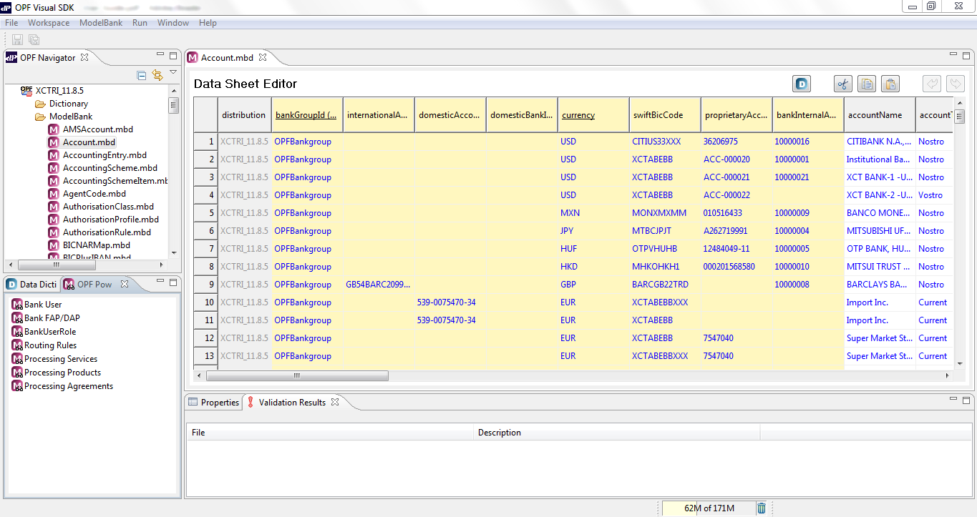
Model Bank

Slide 17
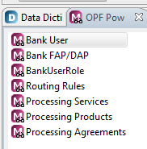
PowerViews
OPF Visual SDK includes a set of powerful views (a.k.a. "PowerViews") that simplify some of the complex relationships that exist between different ModelBank files
The tool will aggregate the information from multiple entities into a single, easy to use and maintain representation.
The following only 7 PowerViews have been implemented in VSDK:

Slide 18
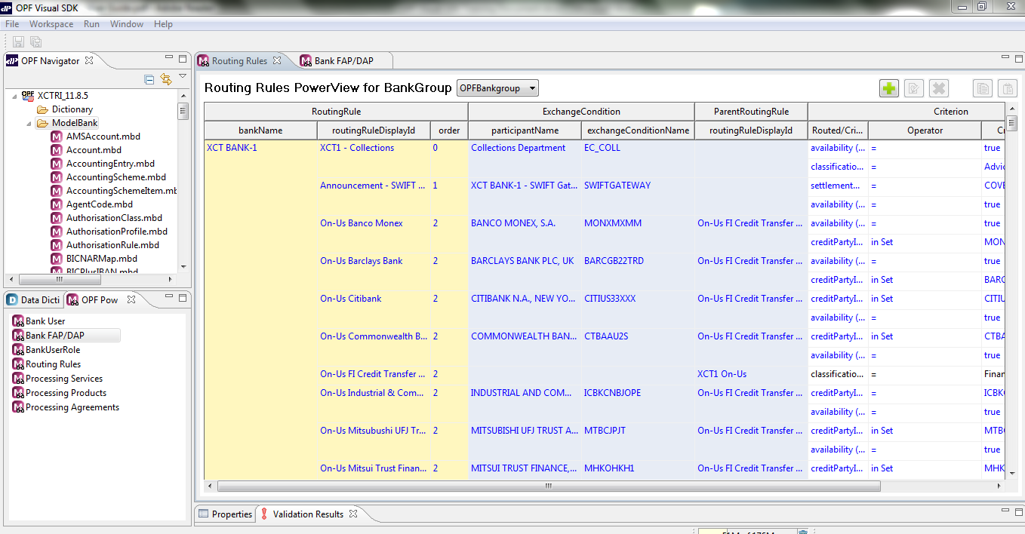
PowerViews

Slide 19
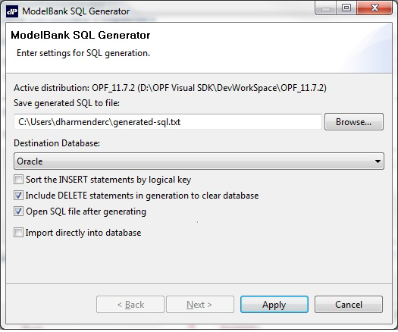
Generating SQL statements
The ModelBank SQL Generator is an optional plug-in that can generate SQL statements based on the data in the ModelBank files.
The output of the plug-in will be stored in a file that can be used to populate an OPF instance in batch mode or directly into a running Oracle RDBMS.
Select “Run” from the menubar and choose “Generate ModelBank SQL” to get this Wizard:

Slide 20
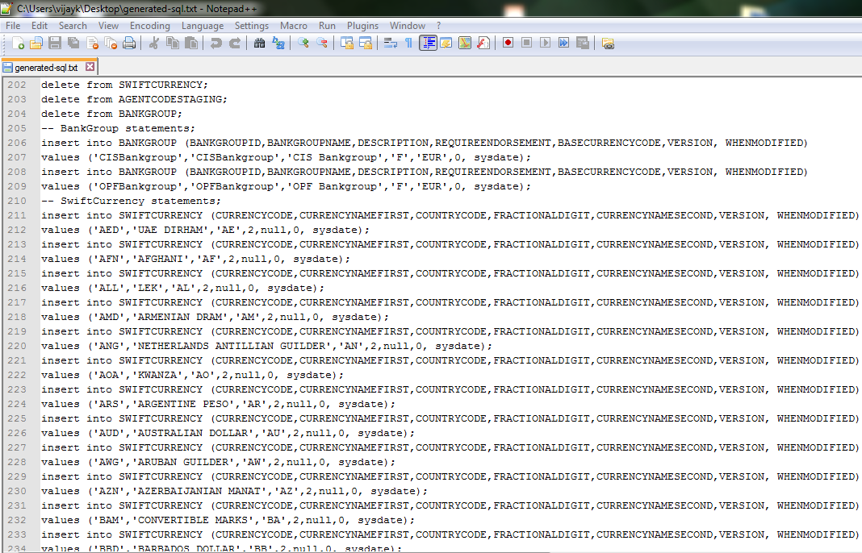
Generating SQL statements

Slide 21
Flat File Parser
Flat-file parser defined in 5 “visual” steps
- General: parser name, record delimiter, character set, …
- Structure: layout of records and fields
- Preview: visualization of structure on sample file
- Mapping: rules that map message on OPF entities
- Actions: technical details about the Parser config files
Menu option to generate the parser XML config files
- used by OPF Parser service.
Visual feedback to assist / guide the user
- from business & technical perspective

Slide 22
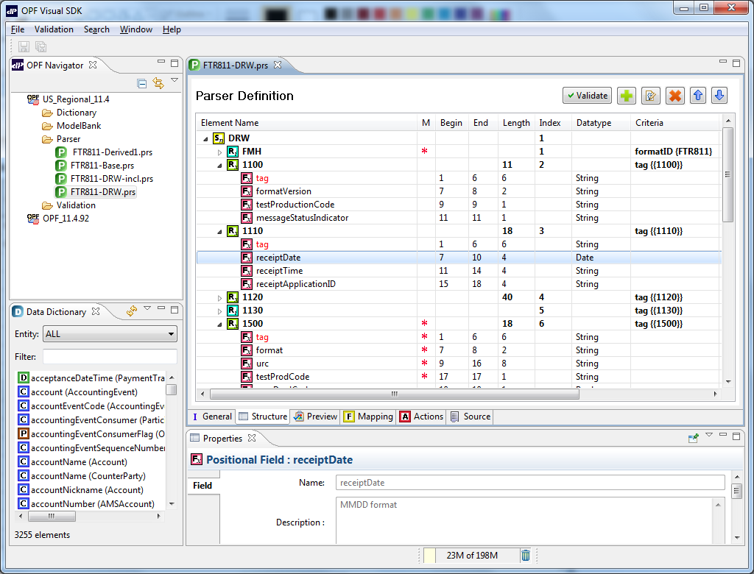
Parser - Message Structure
Record structure with fields
Parser Repository
Field properties

Slide 23
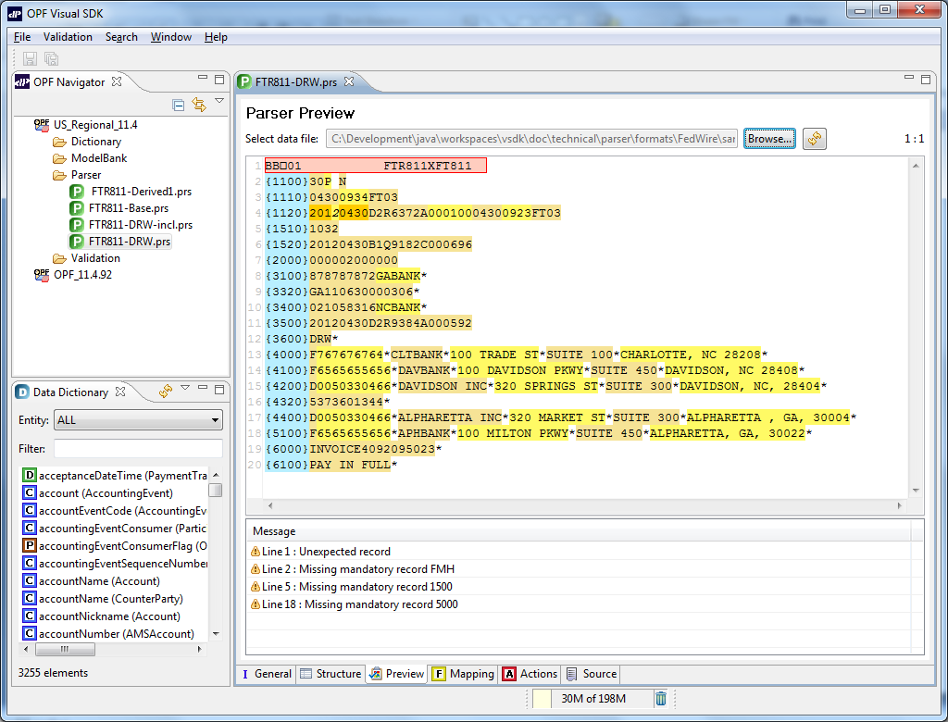
Parser - Message Preview
Sample File Preview
Error Messages

Slide 24
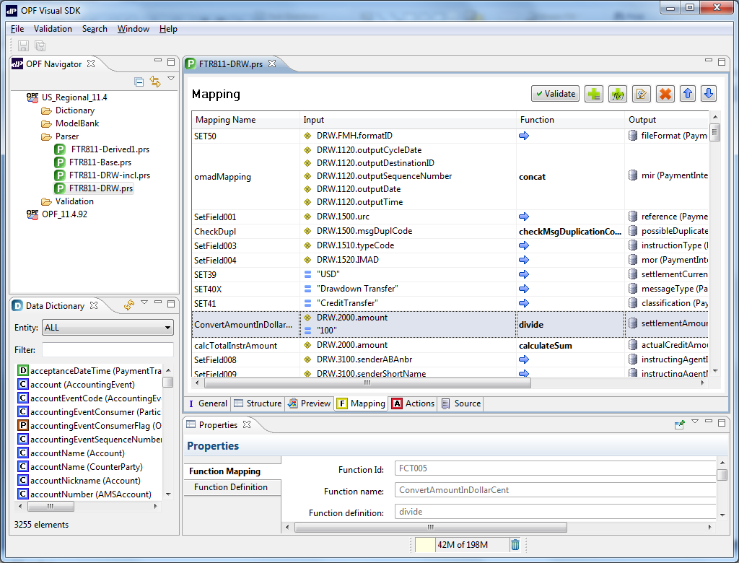
Parser - Message Mapping
Field Assignments
Function mapping
Function properties

Slide 25
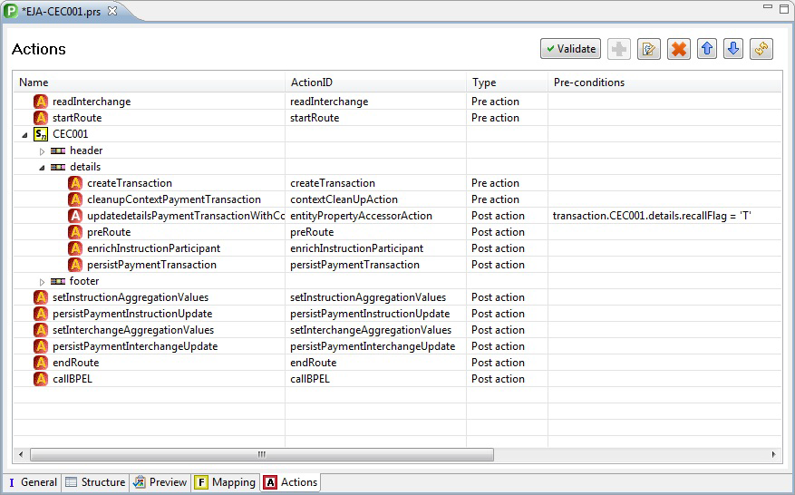
Parser Editor for Actions

Slide 26
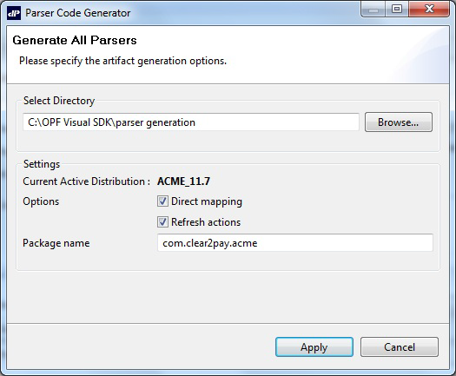
Generating the Configuration files
After completing the different phases (General, Structure, Mapping and Actions tab) in the Parser editor, the user can generate the corresponding XML configuration files that can be used by the OPF Parser service.
Select "Run" from the menubar and select "Generate Parser Code" from the menu to display the "Parser Code Generator" dialog box.

Slide 27

Visual SDK Roadmap
More support for OPF Business Services.
Submission Service
XML Parser Service
OPF Visual Toolkit

Slide 28
Thank you…
vsdk.product@clear2pay.com

